Slide 1
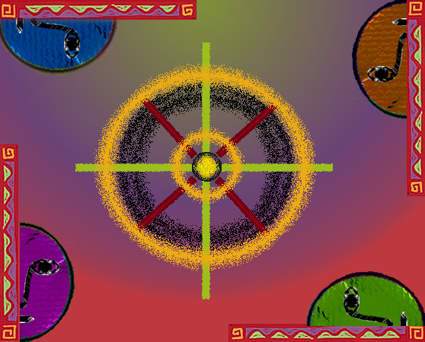
The Organizational Environment
Lesson 2

Slide 2
Organizational Environment
Organizational Environment: those forces outside its boundaries that can impact it.
  Forces can change over time and are made up of Opportunities and Threats.
Opportunities: openings for managers to enhance revenues
  New technologies, new markets and ideas.
Threats: issues that can harm an organization.
  economic recessions.
Managers must seek opportunities and avoid threats.

Slide 3
Forces in the Organizational Environment
Figure 3.1
General
Environment
Technological
Forces
Task
Environment
Sociocultural
Forces
Competitors
Global
Forces
Suppliers
Firm
Customers
Economic
Forces
Distributors
Political &
Legal Forces
Demographic
Forces

Slide 4
Task Environment
Task Environment: forces from suppliers, distributors, customers, and competitors.
Suppliers: provide organization with inputs
  Managers need to secure reliable input sources.
  Suppliers provide raw materials, components, and even labor.

Slide 5
Task Environment
Distributors: organizations that help others to sell goods.
  Compaq Computer first used special computer stores to sell their computers but later sold through discount stores to reduce costs.
  Some distributors like Wal-Mart have strong bargaining power.
    They can threaten not to carry your product.
Customers: people who buy the goods.
  Usually, there are several groups of customers.
    For Compaq, there are business, home, & government buyers.

Slide 6
Task Environment
Competitors: other organizations that produce similar goods.
  Rivalry between competitors is usually the most serious force facing managers.
  High levels of rivalry often means lower prices.
    Profits become hard to find.

Slide 7
Industry Life Cycle
Reflects the changes that take place in an industry over time.
Birth stage: firms seek to develop a winning technology.
  VHS vs. Betamax in video, or 8-track vs. cassette in audio.
Growth stage: Product gains customer acceptance and grows rapidly.
  New firms enter industry, production improves, distributors emerge.

Slide 8
Shakeout stage: at end of growth, there is a slowing customer demand.
  Competitor rivalry increases, prices fall.
  Least efficient firms fail and leave industry.
Maturity stage: most customers have bought the product
  Relationships between suppliers, distributors more stable.
  Usually, industry dominated by a few, large firms.
Decline stage: falling demand for the product.
  Prices fall, weaker firms leave the industry.

Slide 9
The General Environment
Consists of the wide economic, technological, demographic and similar issues.
  Managers usually cannot impact or control these.
  Forces have profound impact on the firm.
Economic forces: affect the national economy and the organization.
  Includes interest rate changes, unemployment rates, economic growth.
  When there is a strong economy, people have more money to spend on goods and services.

Slide 10
Technological forces: skills & equipment used in design, production and distribution.
  Result in new opportunities or threats to managers.
  Often make products obsolete very quickly.
  Can change how we manage.
Socialcultural forces: result from changes in the social or national culture of society.
  Social structure refers to the relationships between people and groups.
    Different societies have vastly different social structures.
  National culture includes the values that characterize a society.
    Values and norms differ widely throughout the world.
  These forces differ between cultures and over time.

Slide 11
The Industry Life Cycle
Figure 3.3
Birth
Growth
Shakeout
Maturity
Decline

Slide 12
Demographic forces: result from changes in the nature, composition and diversity of a population.
  These include gender, age, ethnic origin, etc.
    For example, during the past 20 years, women have entered the workforce in increasing numbers.

Slide 13
Political-legal forces: result from changes in the political arena.
Global forces: result from changes in international relationships between countries.
  Perhaps the most important is the increase in economic integration of countries.
  Free-trade agreements (GATT, NAFTA, EU) decreases former barriers to trade.
  Provide new opportunities and threats to managers.

Slide 14
Managing the Organization Environment
Managers must measure the complexity of the environment and rate of environmental change.
Environmental complexity: deals with the number and possible impact of different forces in the environment.
  Managers must pay more attention to forces with larger impact.
  Usually, the larger the organization, the greater the number of forces managers must oversee.
The more forces, the more complex the manger’s job becomes.

Slide 15
Environmental change: refers to the degree to which forms in the task and general environments change over time.
  Change rates are hard to predict.
  The outcomes of changes are even harder to identify.
Managers thus cannot be sure that actions taken today will be appropriate in the future given new changes.

Slide 16
Reducing Environmental Impact
Managers can counter environmental threats by reducing the number of forces.
All levels of managers should work to minimize the potential impact of environmental forces.
  Examples include reduction of waste by first line managers, determining competitor’s moves by middle managers, or the creation of a new strategy by top managers.

Slide 17
Organizational Structure
Managers can create new organizational structures to deal with change.
  Many firms use specific departments to respond to each force.
Managers also create mechanistic or organic structures.
  Mechanistic structures have centralized authority.
    Roles are clearly specified.
    Good for slowly changing environments.
  Organic structures authority is decentralized.
    providing quick response to change.

